Slide 1

Portable Computing
Würth Eric

Slide 2
What is a portable Computer?
A computer designed to be easily carried and used anywhere.
Runs on battery.
Has an integrated screen, keyboard, and often a touchpad.

Slide 3
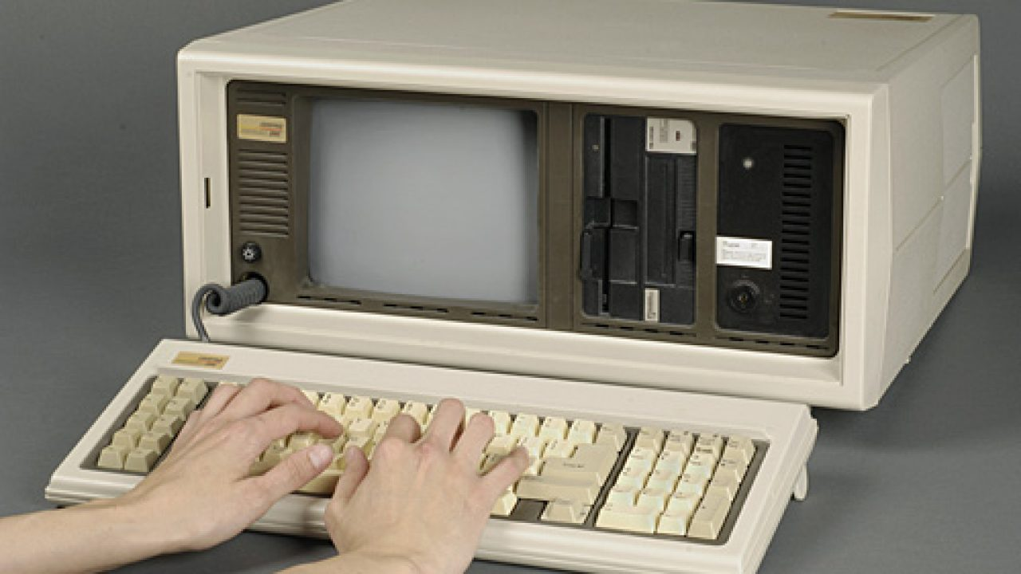
Key Milestones
1980s – Portable but heavy and needed power outlet.
1990s – Batteries -> work anywhere,
2000s – Thin & lighter portables.
2010s – Touch screens, tablets.
2020s – Foldable screens, AI build in.

Slide 4

Landmark Devices
Osborne 1: First commercial "portable" computer.
IBM Thinkpad: Modern laptop design.
Apple iBook: First consumer Wi-Fi laptop.
Apple iPad (2010): Mainstream tablet computing
Galaxy Fold (2019): Foldable display device

Slide 5
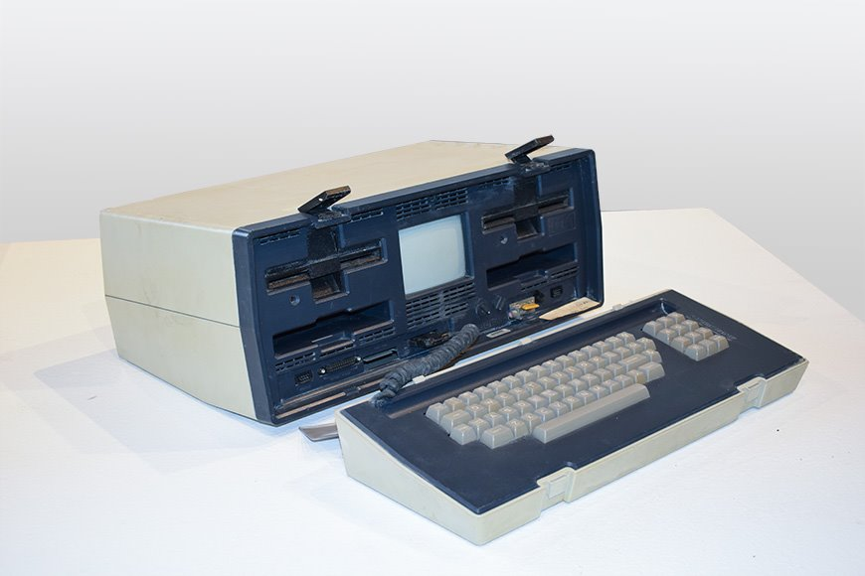
Osborne 1
CPU: Zilog Z80 @ 4 MHz.
RAM: 64 KB.
Storage: Two 13.3cm floppy drives. (91KB)
Weight: ~11 kg

Slide 6
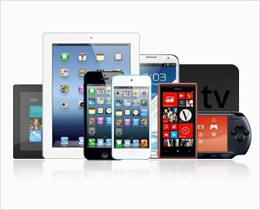
Modern Portable Computers
Sleeker, lighter, and more powerful than early devices.
Features: long battery life, high-resolution screens, fast SSD storage.
Connectivity: Wi-Fi, Bluetooth, USB-C, Thunderbolt.
Examples: Laptops, Tablets, Smartphones etc.

Slide 7
Then vs Now
Weight: 11kg -> 1.2kg
Ram: 64KB -> 16GB
Storage: 182KB -> 512GB
Battery: None -> 18hours

Slide 8
Portable Computer Hardware
Many components soldered directly: CPU, GPU, RAM, storage.
Pros: Saves space, lower power consumption.
Cons: Limited upgrades, more expensive repairs, harder to upgrade.

Slide 9

CPU Architectures Overview
x86.
ARM.
RISC-V.

Slide 10
x86 Architecture
Strengths.
High performance.
Strong software compatibility.
Good for workloads like CAD, gaming, coding.
Weaknesses.
Higher power draw.
Generates more heat.
Often needs active cooling (fans).

Slide 11
ARM Architecture
Strengths.
Very energy efficient.
Runs cool → passive cooling possible.
Long battery life.
Highly integrated SoCs.
Weaknesses.
Historically weaker high-end performance.
Software compatibility issues on some laptops.

Slide 12
RISC-V Architecture
Strengths.
Open-source instruction set.
Extremely customizable.
Very low power -> great for wearables.
Weaknesses.
Software ecosystem still young.
Limited consumer hardware (for now).

Slide 13
CPU Architecture Summary
x86: High power, best performance, expensive -> laptops &desktops.
ARM: Low power, efficient, runs cool -> phones & tablets.
RISC-V: Open-source, very low power -> IoT & wearables.

Slide 14

Cooling Solutions
Passive: No fans, silent (phones, tablets)
Active: Fans + heatsinks (most laptops)
Vapor Chamber: Liquid evaporation (gaming laptops or smartphones)
Liquid: Water loops (gaming laptops or smartphones)

Slide 15
Battery & Efficiency
Efficient CPUs.
Low-power displays.
Sleep states.
Smaller nm chip processes.

Slide 16
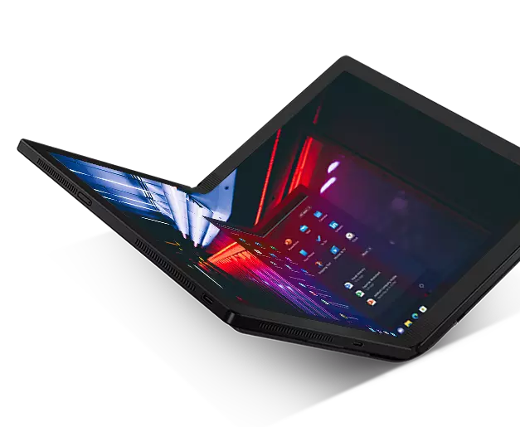
Why Foldable / Dual Screen Devices exist?
Solves big screen vs portability problem.
Flexible OLED displays.
Productivity & media benefits

Slide 17
Integration & Soldering.
RAM & Storage often soldered.
Saves space.
Enables thinner devices.
Downside: no upgrades/repairs.
Reduces power usage.

Slide 18

Advantages
Mobility: Work anywhere — home, school, café, travel.
All-in-One Design: Built-in screen, keyboard, battery, and touchpad.
Energy Efficient: Runs on battery, lower power consumption than desktops.
Space Saving: Compact, lightweight, easy to carry.

Slide 19

Disadvantages
Limited Power: Smaller CPUs/GPUs → less performance than desktops.
Battery Life: Finite; needs recharging.
Limited Upgrades: RAM, storage, and CPU often soldered to motherboard.
Cooling Constraints: Small fans → can overheat under heavy use.
Fewer Ports: Less space for multiple connections.
Smaller Screen / Keyboard: Can limit comfort for long work sessions.

Slide 20
Use cases
Education: Laptops & tablets for schoolwork, research, and online classes.
1
Work & Productivity: Office tasks, presentations, remote work, business travel.
2
Entertainment: Streaming videos, gaming, reading, social media.
3
Communication: Video calls, messaging, emails — stay connected anywhere.
4

Slide 21
Connectivity Evolution
Wi-Fi & Bluetooth
4G / 5G Cellular
USB-C / Thunderbolt
Cloud Services

Slide 22
Future of Portable Computers
Foldable & dual screens.
AI acceleration.
Cloud integration.
Sustainability & repair laws.
Battery tech improvements.

Slide 23
Impact on Society
Education: Anywhere access to learning.
Work: Remote work & digital nomadism.
Healthcare: Mobile diagnostics, telemedicine.
Communication: Always connected.

Slide 24
Conclusion
Portable computers evolved from luggables → sleek, powerful devices.
Enable work, study, play anywhere.
Future trends: mobility, AI, sustainability.

Slide 25

Questions

